Slide 1
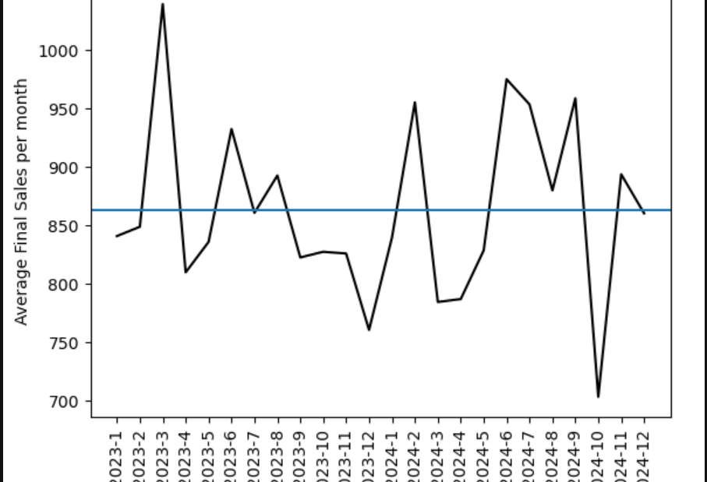
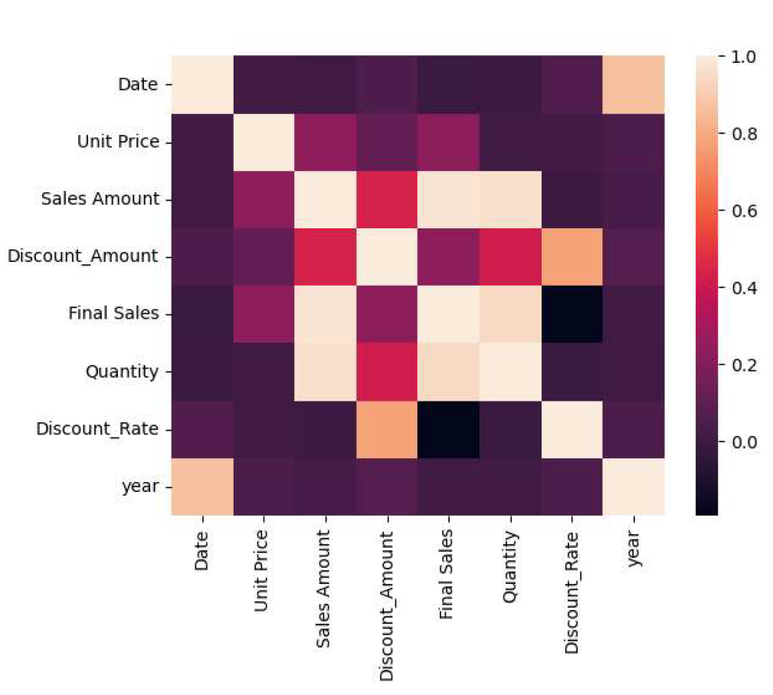
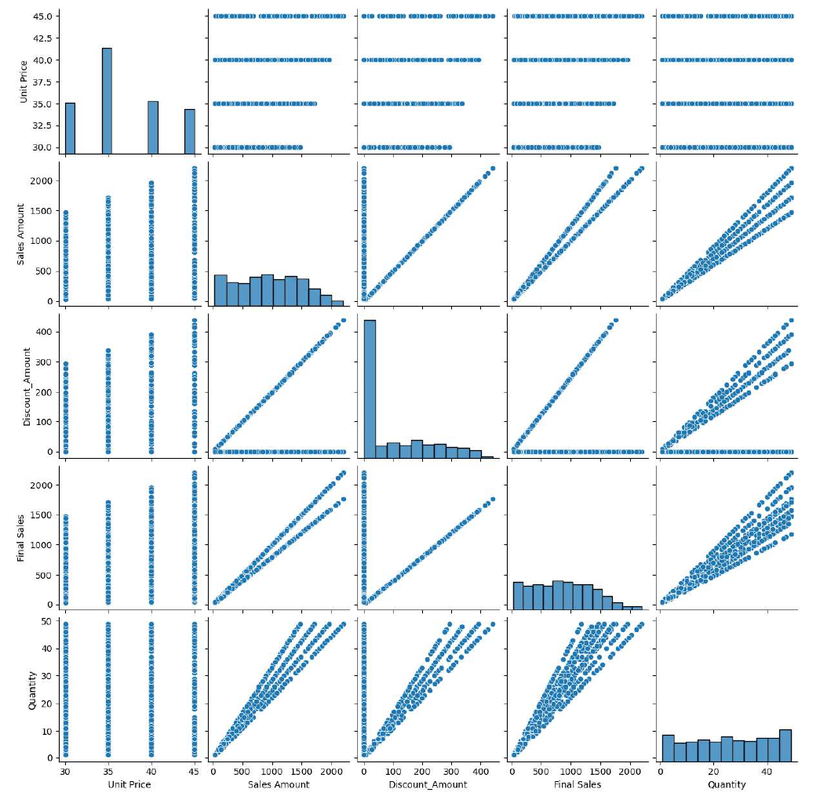
Coffee Beans Data Analysis Summary
Finding trends and variables to build model
A coffee bean distribution in Saudi Arabia request to analyze sales data and find any
trends of sales. In this project, Seungsoon performs preliminary inspection of data supplied by clients to find any key variables and meaningful insights.
Coffee bean sales fluctuate yearly, rising early in the year, dipping in spring, increasing in summer, and dropping again. The decline from March to April may be linked to Ramadan, which influences consumption patterns.
Found linear relationship between final sales, quantity and sales amount.
Develop a predictive model to analyze final sales and assess the impact of discounts.
Assess the model's performance and validate its assumptions
- Build the final executive summary.

